Slide 1

Ball Corporation
2024 Iowa Graduate Business Analytics Case Competition

Slide 2
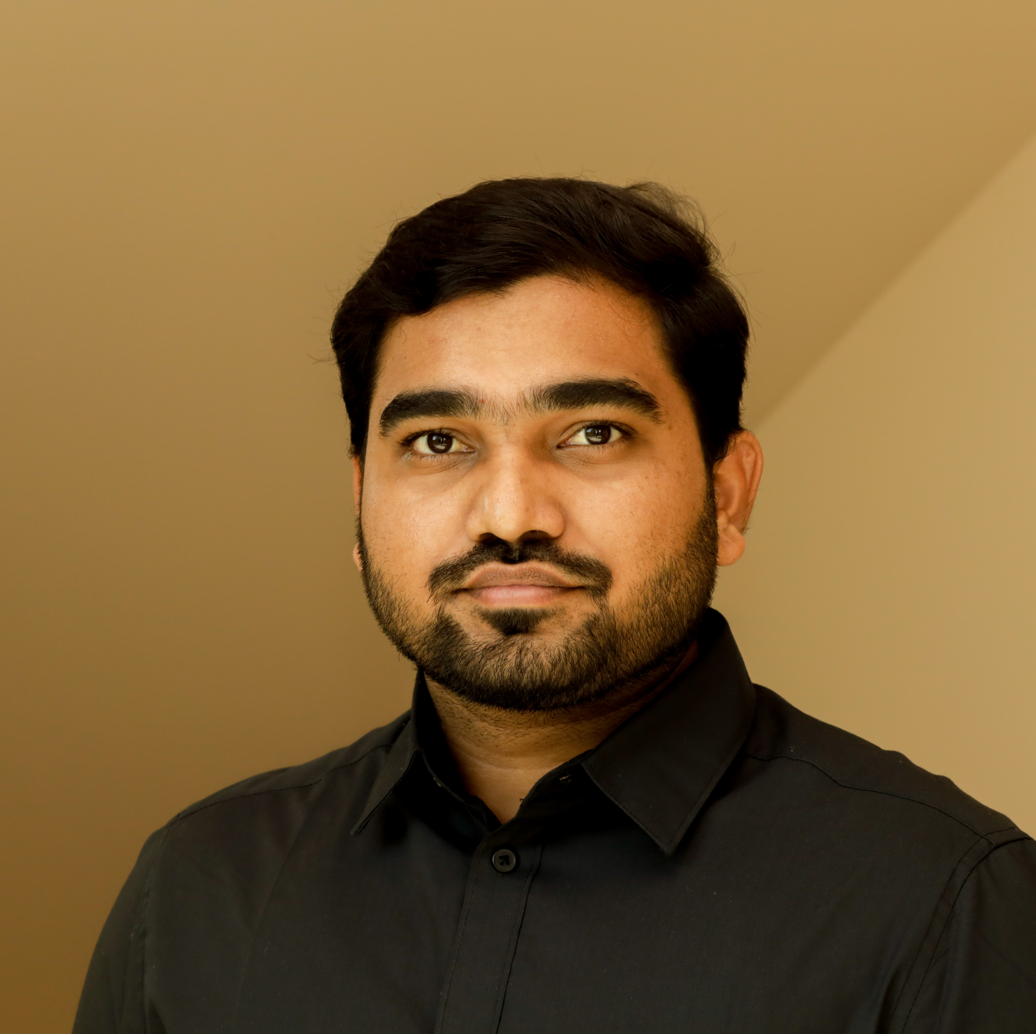

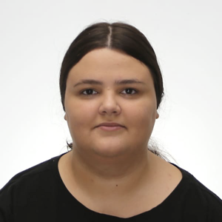
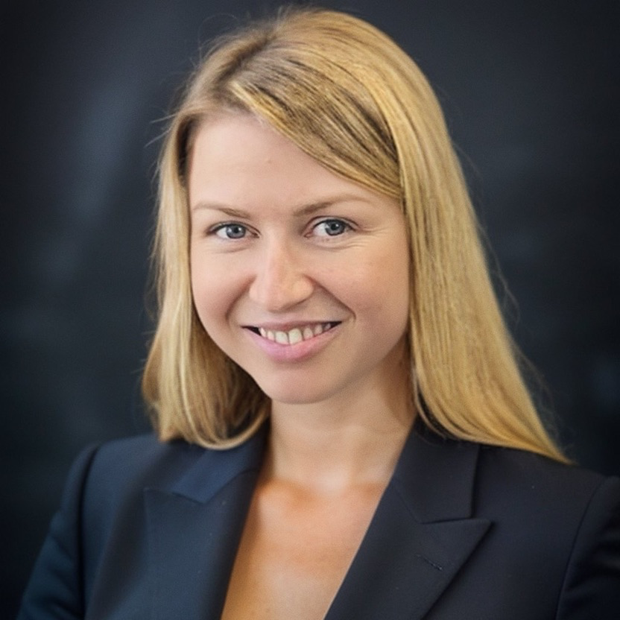
TEAM - 07
Siddarth Gopalakrishnan
Imtiaz Chowdhury
Anna Bezshkura
Anastasiia Prydius

Slide 3
3.1%
20%
Turnover in the Manufacturing Industry (2024) while around 40% of turnover took place within the first year of employment
Decrease in productivity in Manufacturing Industry mainly driven by sub-optimal and inefficient workforce

Slide 4
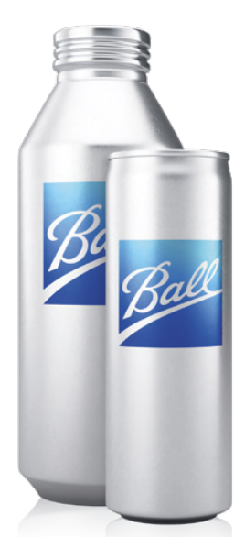
Ball Corporation
Business
Employee Mobility
Global leader in metal packaging for food, beverages, and household products
Post Covid, Employee mobility is increasing leading to greater levels of employee turnover
Vision
Optimum Workforce
Providing eco-friendly packaging solutions that minimize environmental impact
Ensuring optimum workforce profile to support manufacturing facilities.
Production Plants
Organizational Health
60+ production facilities and 21,500 employees around the globe
Enhance employee experience driving improved organizational health
Case
Overview
Exploratory Data Analysis
Optimum Workforce
Dynamic Dashboard
Strategies
Conclusion
Notes:
Explain our understanding of optimal workforce and successful operational facility and our approach of it as a balance between two.

Slide 5
Problem Statement & Action Plan
Identifying what constitutes a successful manufacturing facility and key drivers for assessing the overall organizational health of manufacturing facilities in relation to the people who work in Ball Corporation
Problem Statement
Exploratory Data Analysis
Optimum Workforce
Dynamic Dashboard
Strategies and Recommendations
Action
Plan
Identifying the relationships among the variables and their pattern
Determination of optimum workforce and successful facility using scipy library
Creating dynamic dashboard to monitor the big 4 operational metrics and their drivers
Recommending strategies to achieve optimum workforce
Case
Overview
Exploratory Data Analysis
Optimum Workforce
Dynamic Dashboard
Strategies
Conclusion
Notes:
Our approach to define this balance:
Explain what influences
Compare models to define optimal balance
Create dashboar for monitoring afterwords
And we provide recommendations based on these

Slide 6
Exploratory Data Analysis

Slide 7
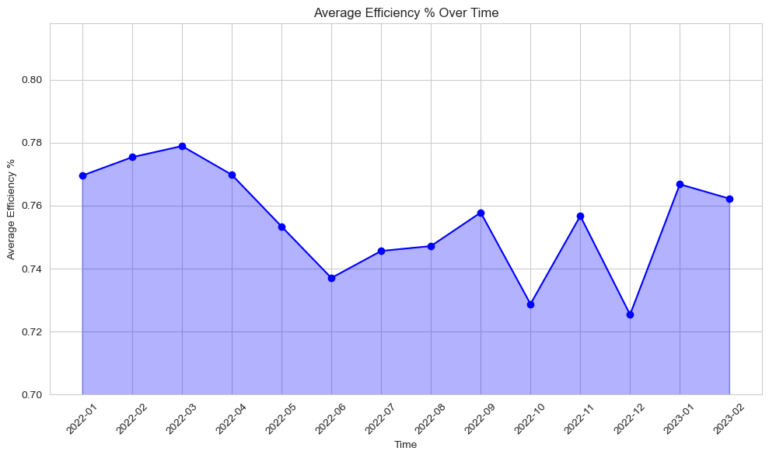
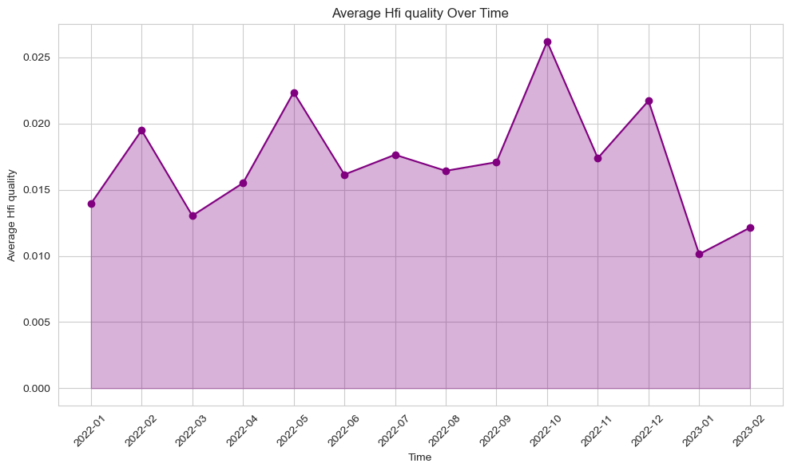
Average Efficiency and HFI Quality over Time
Average Efficiency % Over Time
Average HFI Quality % Over Time
Case
Overview
Exploratory Data Analysis
Optimum Workforce
Dynamic Dashboard
Strategies
Conclusion
Notes:
The highest peaks in efficiency is lowest in quality and visa versa.

Slide 8
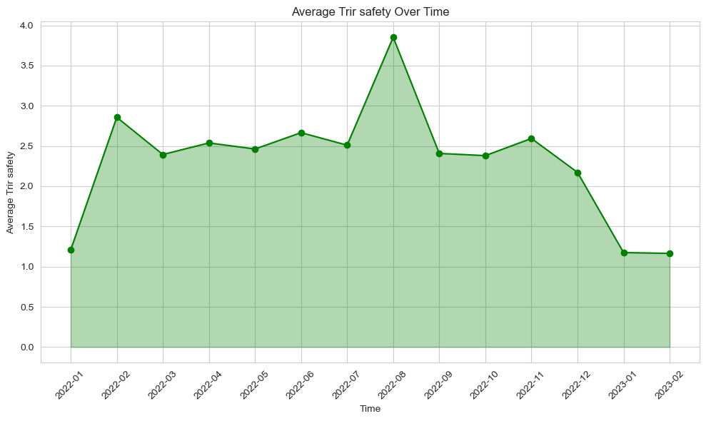
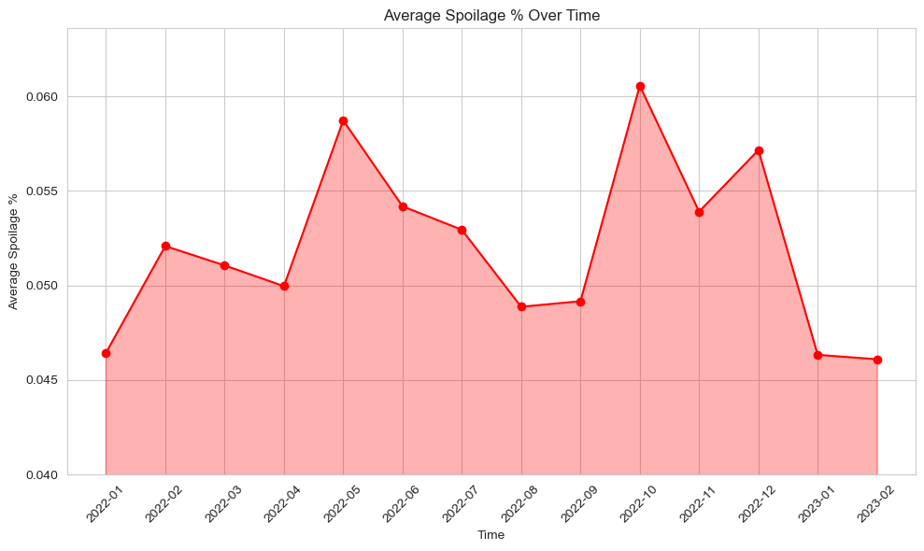
Average Safety and Spoilage over Time
Average TRIR Safety Over Time
Average Spoilage % Over Time
Case
Overview
Exploratory Data Analysis
Optimum Workforce
Dynamic Dashboard
Strategies
Conclusion
Notes:
But when we were looking on other variables there was not clear patter, but some of the peaks in lowest safety correspond to lower Spoilage.

Slide 9
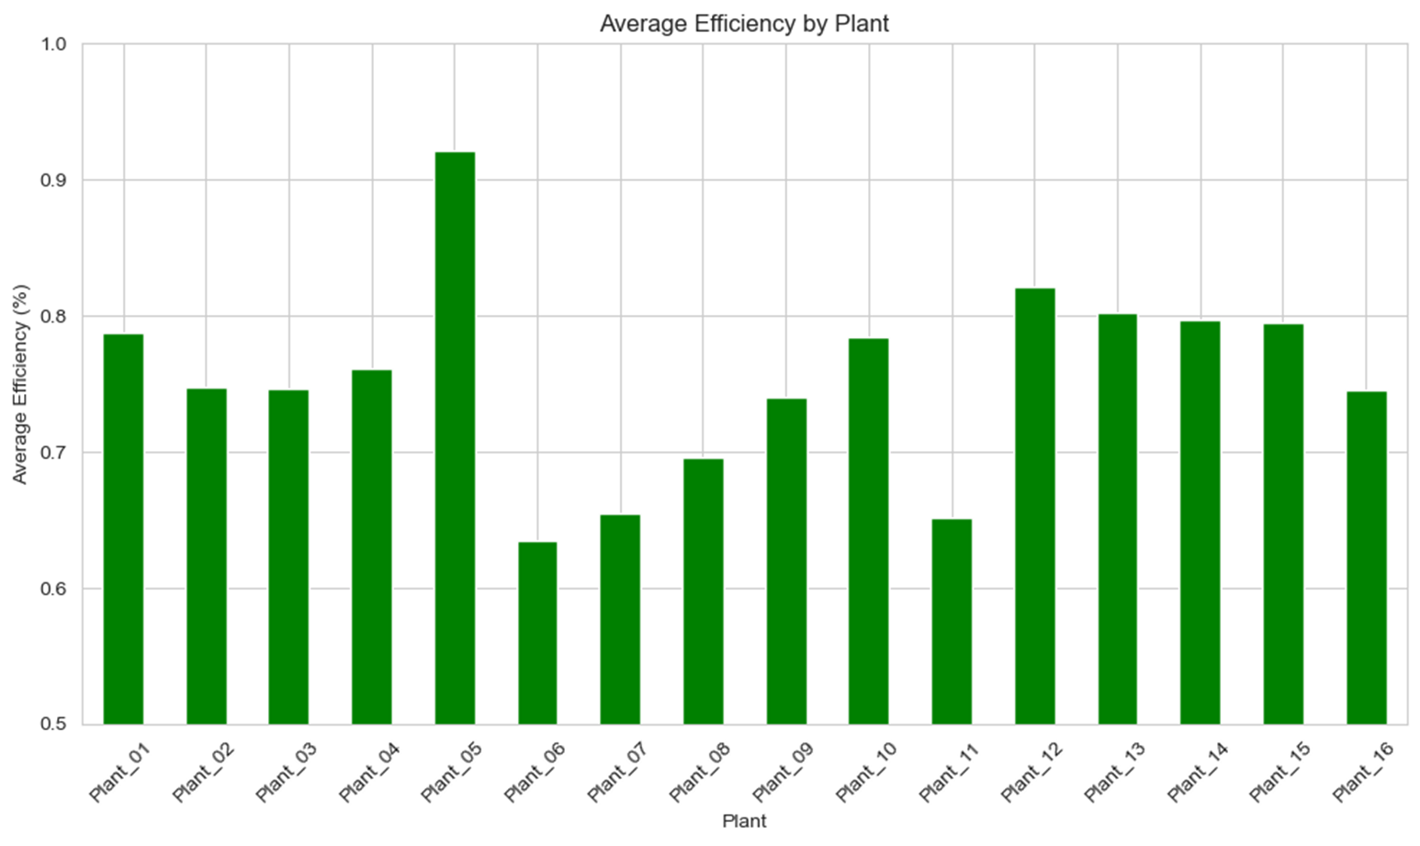
Average Efficiency By Plants
Case
Overview
Exploratory Data Analysis
Optimum Workforce
Dynamic Dashboard
Strategies
Conclusion
Notes:
We have discovered the differences between plants, especially for efficiency there were some plants with higher and lower efficiency compared to majority. The Plant 5 was truly overperforming others.

Slide 10
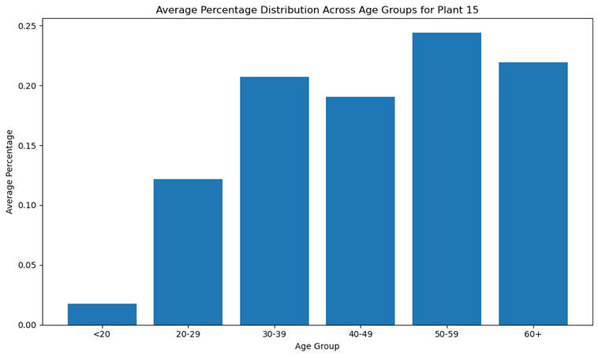
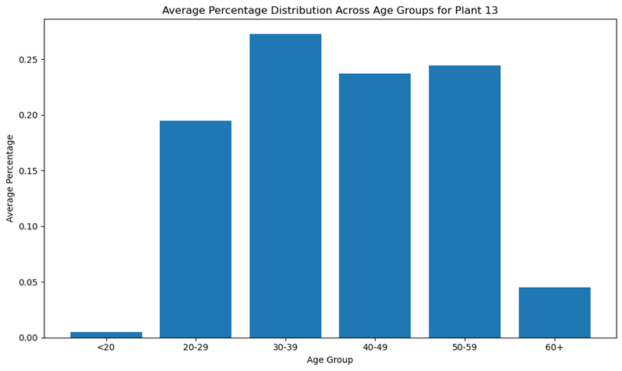
Age Distribution Across Plants
Plant 15: Average Age Distribution Across Age
Plant 13: Average Age Distribution Across Age
Case
Overview
Exploratory Data Analysis
Optimum Workforce
Dynamic Dashboard
Strategies
Conclusion
Notes:
Plant 15 is very distinguishing in terms of age distribution, but others had more or less same pattern. Similar efficiency in both though.

Slide 11
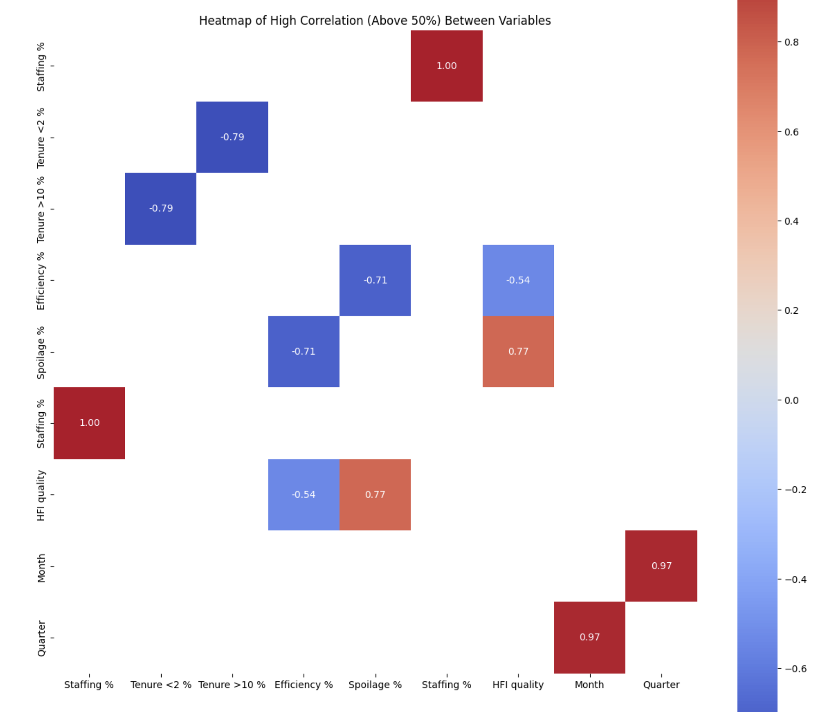
Correlation Matrix : Heatmap
Significant Correlation
Tenure <2
Tenure > 10
Efficiency
Spoilage
HFI Quality
Positive Correlation
Spoilage & HFI Quality
Negative Correlation
Tenure > 10 & Tenure < 2
Efficiency & Spoilage
Efficiency & HFI Quality
Case
Overview
Exploratory Data Analysis
Optimum Workforce
Dynamic Dashboard
Strategies
Conclusion
Notes:
We have looked at the correlation to keep it in mind during modelling stage. The correlation identified is created by the natural way of the variables like efficiency and spoilage.

Slide 12
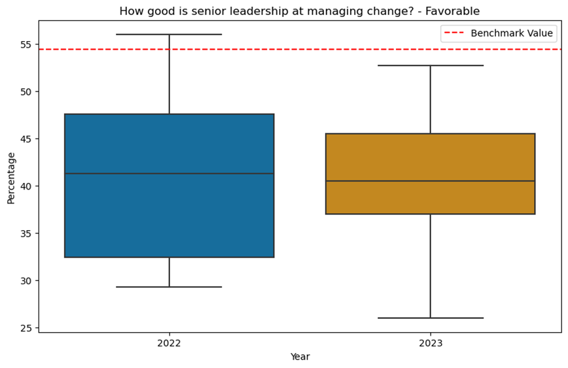
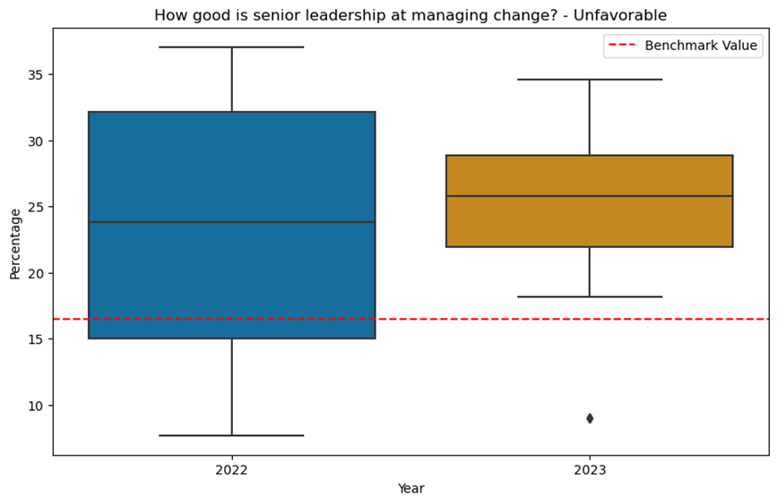
Survey Analysis : Senior Management
Senior Leadership at Managing Change - Favourable
Senior Leadership at Managing Change -Unfavourable
Case
Overview
Exploratory Data Analysis
Optimum Workforce
Dynamic Dashboard
Strategies
Conclusion
Notes:
Moving to the survey results data we have looked we have figure out the favorable responses are below thr benchmarks and they slightly descreased compared to previous year and unfavorable slightly increase.

Slide 13
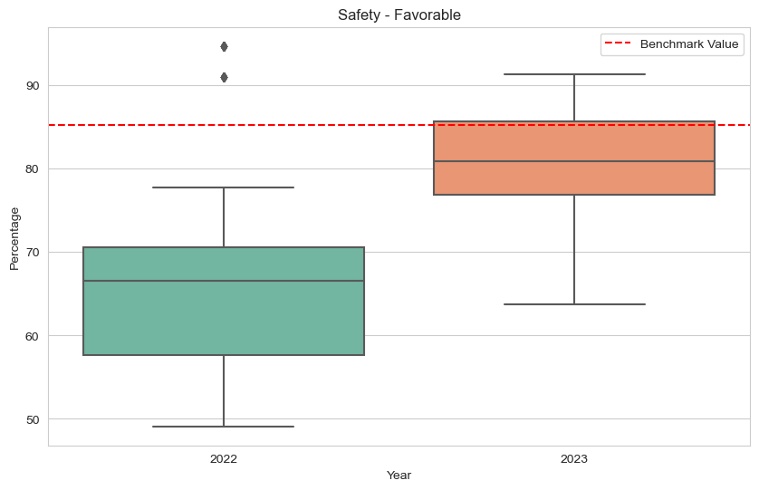
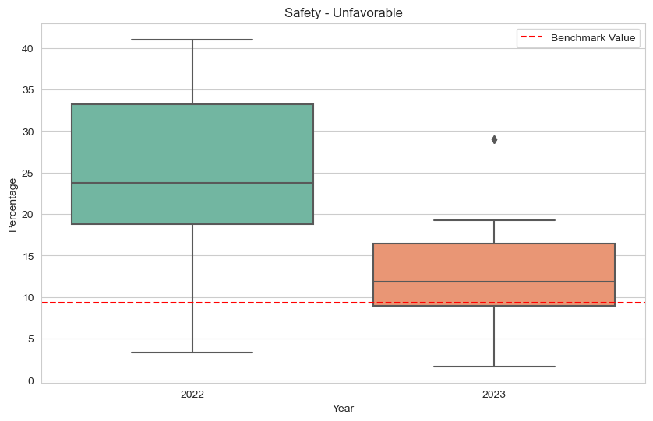
Survey Analysis : Safety Measures
Safety - Favourable
Safety - Unfavourable
Case
Overview
Exploratory Data Analysis
Optimum Workforce
Dynamic Dashboard
Strategies
Conclusion
Notes:
Looking on the peoples perception of the safety, we can observe significant increase in level of safety based on the people's opinions.

Slide 14
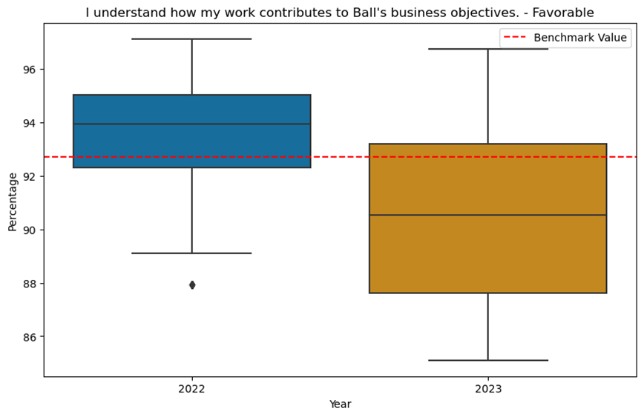
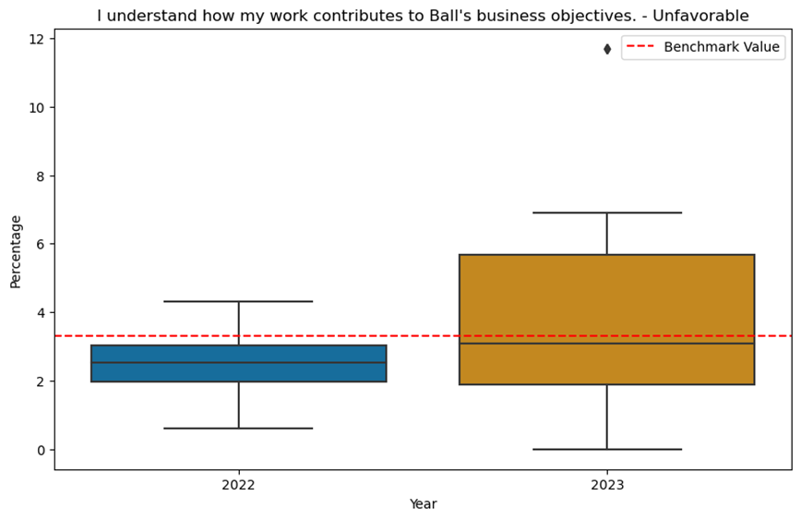
Survey Analysis : Contribution to Company Vision
Case
Overview
Exploratory Data Analysis
Optimum Workforce
Dynamic Dashboard
Strategies
Conclusion
Notes:
Here we observe a big drop in peoples understanding of their contribution.

Slide 15
Optimum Workforce
Notes:
Now lets try to find thre optimum workforce

Slide 16
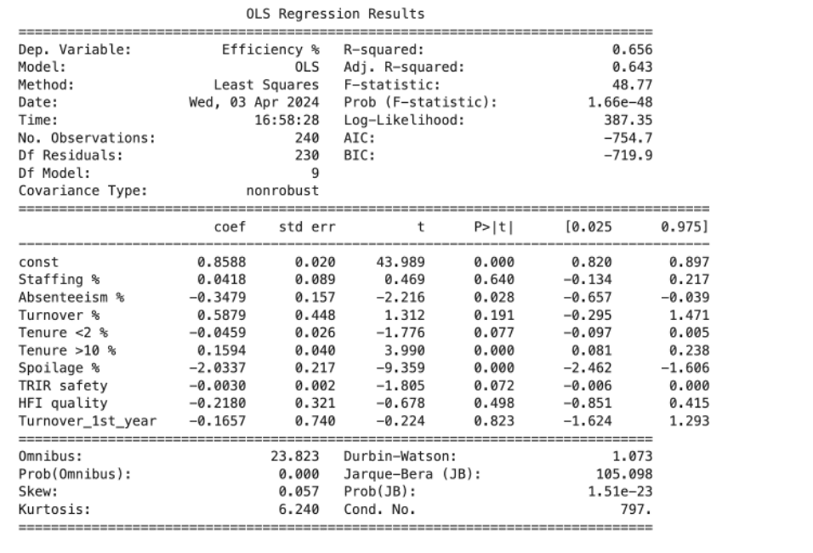
Regression Analysis: Efficiency %
Significant metrics
Absenteeism
Tenure > 10
Spoilage
Positive Impact
Tenure > 10
Negative Impact
Absenteeism
Spoilage
Case
Overview
Exploratory Data Analysis
Optimum Workforce
Dynamic Dashboard
Strategies
Conclusion
Notes:
What drives the operational big 4 operational metrics?How to find it? We approached the Linear regression models to understand theNature of relation between variables, simple & efficient.

Slide 17
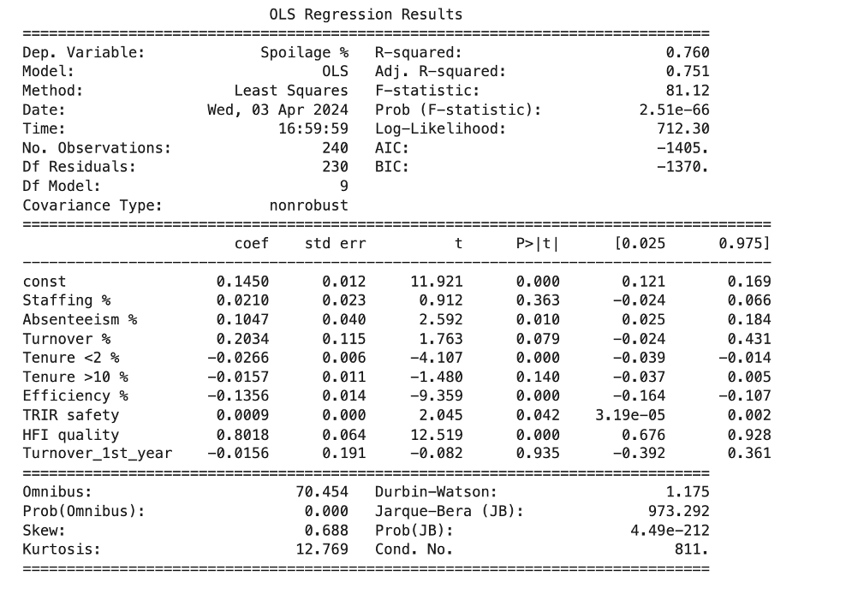
Regression Analysis: Spoilage %
Significant metrics
Absenteeism
Tenure < 2
Efficiency
TRIR Safety
HFI Quality
Positive Impact
Tenure < 2
Efficiency
Negative Impact
Absenteeism
TRIR Safety
HFI Quality
Case
Overview
Exploratory Data Analysis
Optimum Workforce
Dynamic Dashboard
Strategies
Conclusion
Notes:
What are the key drivers behind spoilage?

Slide 18
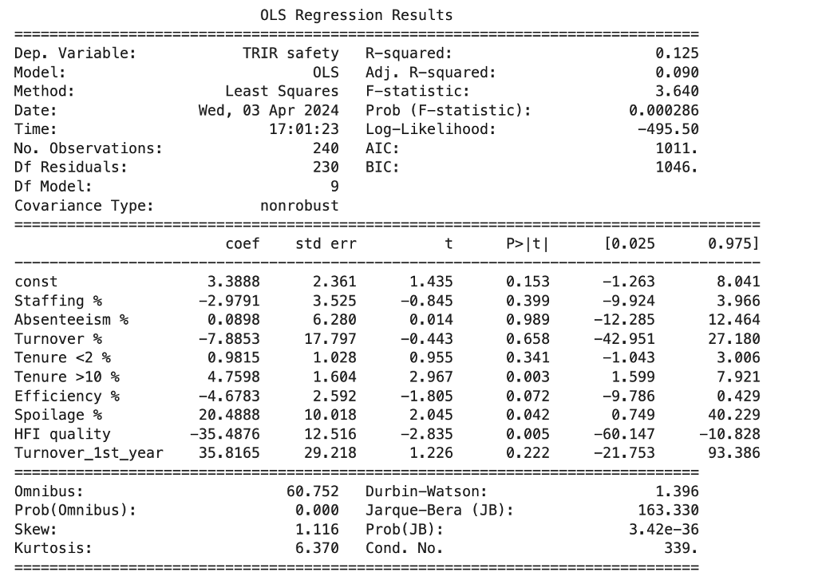
Regression Analysis: TRIR Safety
Significant metrics
Tenure > 10
Spoilage %
HFI Quality
Positive Impact
Tenure > 10
Spoilage %
Negative Impact
HFI Quality
Case
Overview
Exploratory Data Analysis
Optimum Workforce
Dynamic Dashboard
Strategies
Conclusion
Notes:
What defines TRIR safety? Not all HFI quality will lead to TRIR but chances of reporting are high.

Slide 19
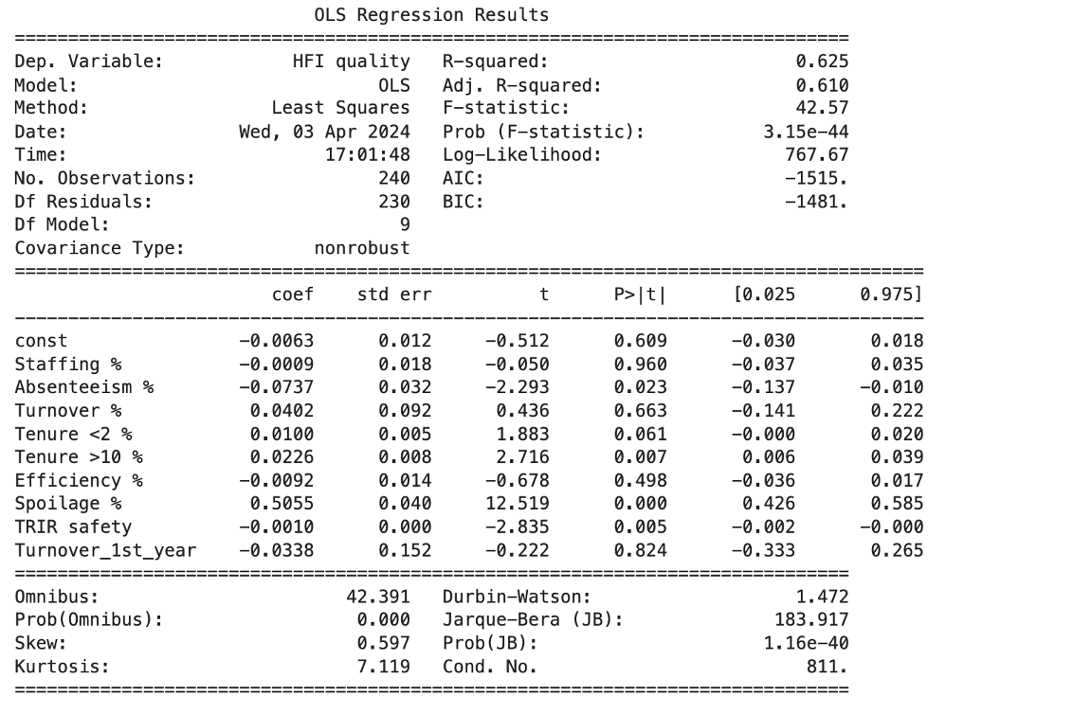
Regression Analysis: HFI Quality
Significant metrics
Absenteeism
Tenure > 10
Spoilage
TRIR Safety
Positive Impact
Tenure > 10
Spoilage %
Negative Impact
Absenteeism
TRIR Safety
Case
Overview
Exploratory Data Analysis
Optimum Workforce
Dynamic Dashboard
Strategies
Conclusion
Notes:
What are the key drivers of HFI Quality?

Slide 20
Optimal Operational Big 4 Matrices
91.5%
2.2%
2.23
2.3%
Scipy Library
Method: SLSQP
Efficiency %
Spoilage %
TRIR Safety
HFI Quality
Case
Overview
Exploratory Data Analysis
Optimum Workforce
Dynamic Dashboard
Strategies
Conclusion
Notes:
Once we have identified the relationships between target metrics of operational Big 4 and key drivers, it made a base for our objective functions where we want to maximize efficiency and aim for lowest level in spoilage, safety incidents and quality issues, as well as using data set values range as bounds. Our best performing model shown that best possible efficiency level with current input while showing it's realistically to go minimum at 2% of key drivers.

Slide 21
Optimum Workforce
Slightly overstaffing is needed
Staffing %
1%
Restrict absenteeism to this level
Absenteeism %
1%
Turnover %
5%
Turnover less than 5% is acceptable
No more than 2% turnover in 1st year
Turnover 1st Year %
2%
Less experience shouldn’t be more than 20%
Tenure < 2 %
20%
Experienced people should be more
Tenure > 10 %
60%
Case
Overview
Exploratory Data Analysis
Optimum Workforce
Dynamic Dashboard
Strategies
Conclusion
Notes:
To achieve this successful facility, this is the optimal workforce needs to be achieved. The successful workforce is defined by optimal values in these 6 metrics. We aim for optimal level in staffing which is 0% but having understaffing may be harmful for efficiency. So, coming from the optimal solution, the treshhold for staffing is around 1%. While we aim for minimal level in absenteeism and turnover, the optimal levels allowing for the optimal big 4 is reaching 1, 5,2 and 2% values. The tenure, having high impact on the efficiency level, defines the desirable treshold of 20% and 60% respectively for less and more experience workforce.

Slide 22
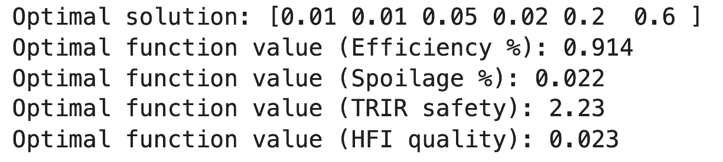


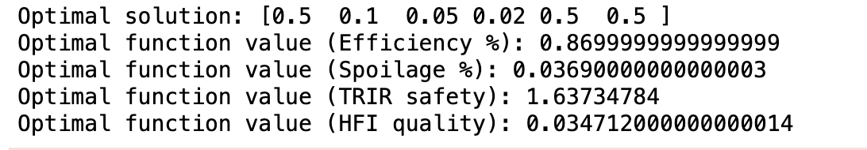
Alternative Methods for Optimization
SLSQP
L –BFGS-B
Optimal solution: [1. 0. 0. 0. 0. 0.] Optimal function value (Efficiency %): 0.8266525850830355
Optimal function value (Spoilage %): 0.000185
Optimal function value (TRIR safety %): 4.056759
Optimal function value (HFI quality %): 0.024807
CG
Case
Overview
Exploratory Data Analysis
Optimum Workforce
Dynamic Dashboard
Strategies
Conclusion
Notes:
These are the alternative models we used. We were looking at how closely each method approaches the ideal outcome for our set of weighted metrics. The highest level of efficiency with minimum possible values of spoilage, quality and safety incidents was shown to be achieved by slsqp that's why we rejected the other two. SLSQP –sequential least squares programming algorithm, limited memory BFGS (parameter estimation in ML), CG –conjugate gradient (numerical solution of particular systems of linear equations, )

Slide 23
Dynamic Dashboard

Slide 24

Dynamic Dashboard for Monitoring
Case
Overview
Exploratory Data Analysis
Optimum Workforce
Dynamic Dashboard
Strategies
Conclusion
Notes:
For the purpose of monitoring the facilities performance and how each one meats the defined optimal levels, we offer dashboard for operational and human resources both. Here you can see a breakdown by plants and their big 4 and workforce metrics in comparison to the define trash hold. For example, plant 8 which we saw earlier is lower than average in terms of efficiency, performs below the threshold while having spoilage, quality and safety incidents above the threshold with spikes. We also observed changes in survey results in 2023 comparing to 2022. For example, we noticed drop in favorable answers related to senior leadership, contribution to business objectives and career advancement reaching below benchmark levels respectfully unfavorable answers going up. We also have a dynamic version of this, if you are interested to see more afterwards.

Slide 25
Strategies for Optimum Workforce

Slide 26
Strategies for Optimum Workforce
Absenteeism
Turnover
Tenure
Manager Effectiveness
Safety
Sustainable Engagement
Career Advancement
Senior Leadership
Manager Effectiveness
Safety
Sustainable Engagement
Career Advancement
Vision & Direction
Manager Effectiveness
Case
Overview
Exploratory Data Analysis
Optimum Workforce
Dynamic Dashboard
Strategies
Conclusion
Notes:
Thus, we wanted to explorer how people perception of work conditions reflected in survey results we've got, effect our major business workforce metrics. Here you see breakdown of survey categories. For example, absenteeism and tenure, which are significant for efficiency medics, are influenced by people feeling about senior leadership, manager effectiveness, safety and other highlighted in blue that forms a basis for our strategy suggestions.

Slide 27
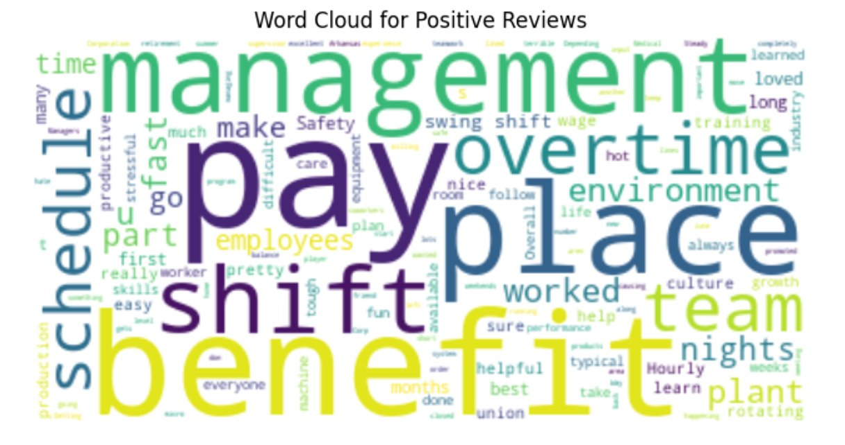
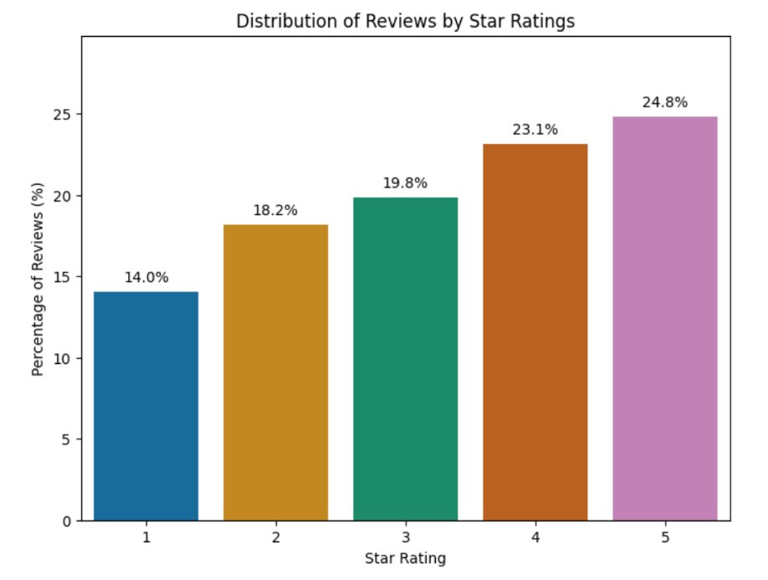
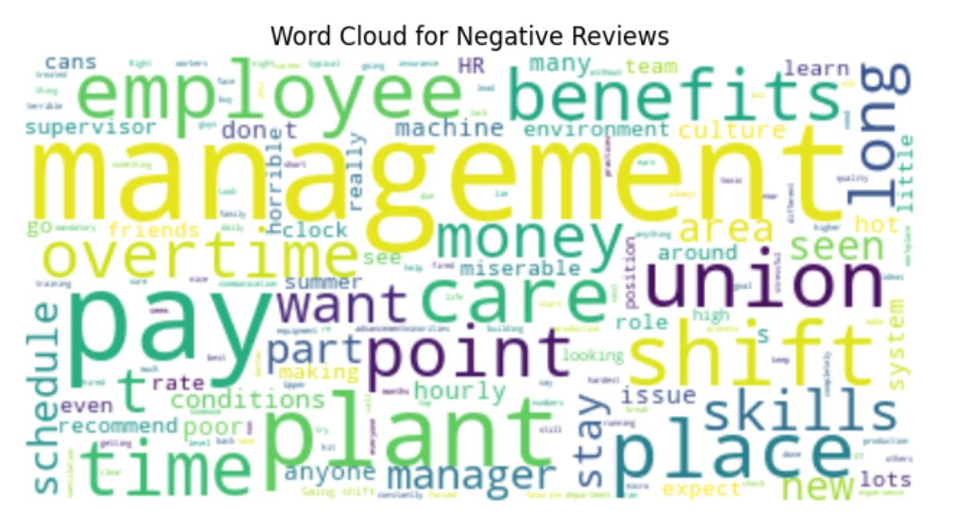
Employees Reviews: Sentiment Analysis
Case
Overview
Exploratory Data Analysis
Optimum Workforce
Dynamic Dashboard
Strategies
Conclusion
Notes:
We went beyond. It's negative and positive, reflecting pay management benefit overtime as positively described, and also management skills place plant kind of addressing safety and quality reflecting our previous discovery. And can be considered as a srategy to widen the feedback format and incorporate text feedback to enrich people perspective on working conditions.

Slide 28
Strategies for Optimum Workforce
Inclusion
Manager Effectiveness
Senior Leadership
Arrange Team Events
Unbiased Reward System
Appreciate New Ideas
Build Respectful Culture
Provide Training on Change Management
Open Communication
Safety
Sustainable Engagement
Career Advancement
Regular EHS Monitoring
Hold Accountable and Reward Teams.
Ensure Proper Working Condition
Improving Work Environment to Prevent Burnout
Introduce Indoor Games in Facilities
Create Structured Career Pathway
Increase Retirement Benefits
Case
Overview
Exploratory Data Analysis
Optimum Workforce
Dynamic Dashboard
Strategies
Conclusion
Notes:
As a results, we suggest to implement human resources strategies which will be focused on creating a positive experience specifically for the areas where we found a significant evidence of making a change. Thus, implementing ideas management tools, change management procedures, enhancing open communication, transparent career pathways and understanding of persanal contibution to the company business goal and using our dashboard for monitoring against the defined trashholds, will allow to improve workforce metrics and as a result, allow possibility for improving efficiency reaching the optimal balance.

Slide 29
Q&A

Slide 30
References
https://www.bls.gov/news.release/jolts.nr0.htm
https://www.bls.gov/news.release/pdf/jolts.pdf
https://builtin.com/recruiting/employee-turnover-statistics
https://www.teamsense.com/blog/reduce-employee-turnover-manufacturing
https://www.bls.gov/opub/ted/2023/labor-productivity-down-in-69-manufacturing-and-mining-industries-in-2022.htm
https://s1.q4cdn.com/288660599/files/doc_downloads/2023/Ball2022_CR_PDF_031423-FINAL1.pdf
https://www.ball.com/our-company/our-culture/drive-for-10
https://s1.q4cdn.com/288660599/files/doc_downloads/2024/2023-ball-corporation-10k.pdf
https://s1.q4cdn.com/288660599/files/doc_downloads/2024/03/2023-combined-report.pdf

Slide 31
APPENDIX

Slide 32
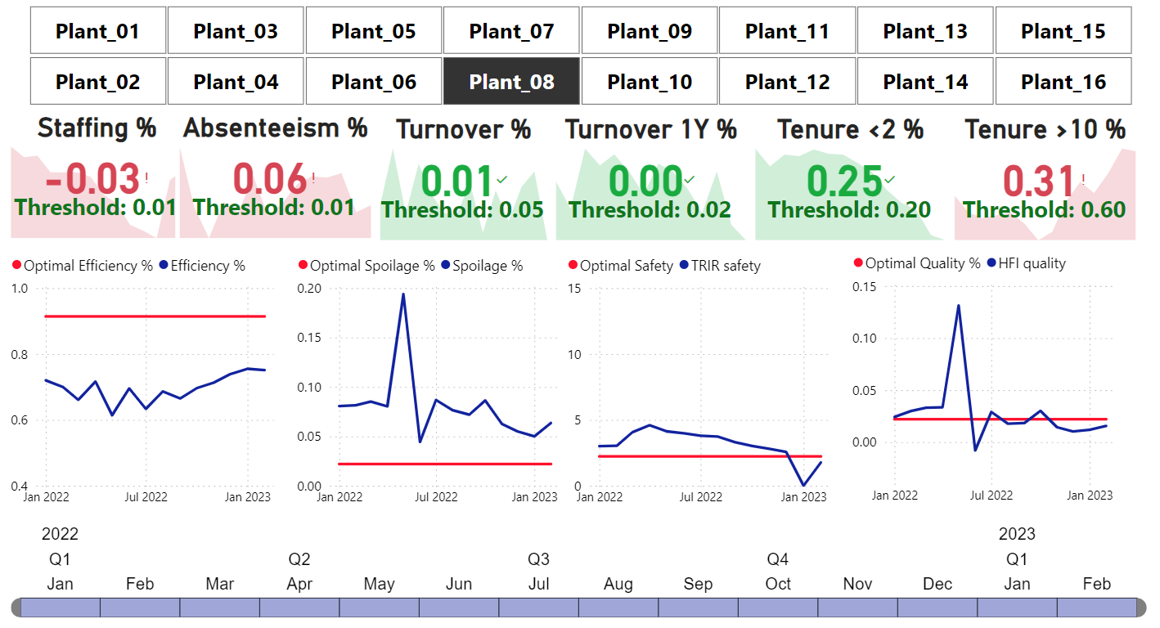
Dynamic Dashboard for Monitoring
Case
Overview
Exploratory Data Analysis
Optimum Workforce
Dynamic Dashboard
Strategies
Conclusion

Slide 33
Ball Corporation
1P_2023 | Senior Leadership
2P_2023 | How good is senior leadership at managing change?
3P_2023 | Senior leadership communicates openly and honestly to employees.
9P_2023 | Manager Effectiveness
10P_2023 | My immediate supervisor/manager treats me with respect.
11P_2023 | My immediate supervisor/manager encourages new ideas and new ways of doing things.
6P_2023 | Inclusion
7P_2023 | My immediate supervisor/manager's commitment to diversity and inclusion is apparent in action, not just words.
8P_2023 | I feel a strong sense of belonging to my department/team.
14P_2023 | Safety
16P_2023 | Sustainable Engagement
15P_2023 | Safety rules are carefully observed, even if it means work is slowed down.
4P_2023 | Career Advancement
5P_2023 | I think Ball offers long-term opportunities for me.
17P_2023 | I believe strongly in the goals and objectives of Ball.
18P_2023 | There are no substantial obstacles at work to doing my job well.
19P_2023 | I am able to sustain the level of energy I need throughout the work day.
12P_2023 | Retention Driver
13P_2023 | At the present time, are you seriously considering leaving Ball?
20P_2023 | Vision & Direction
21P_2023 | I understand how my work contributes to Ball's business objectives.

Slide 34
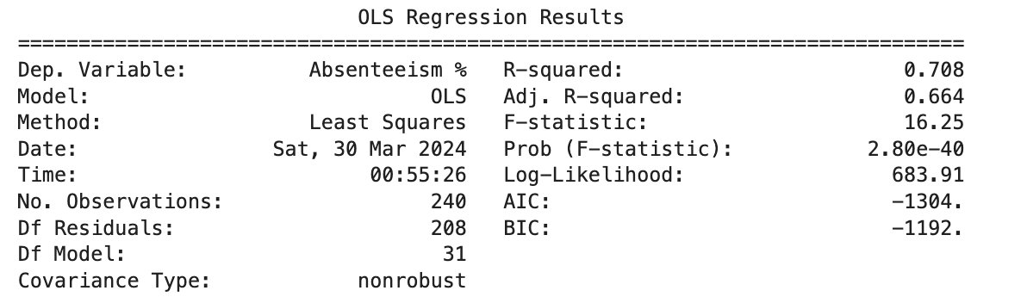
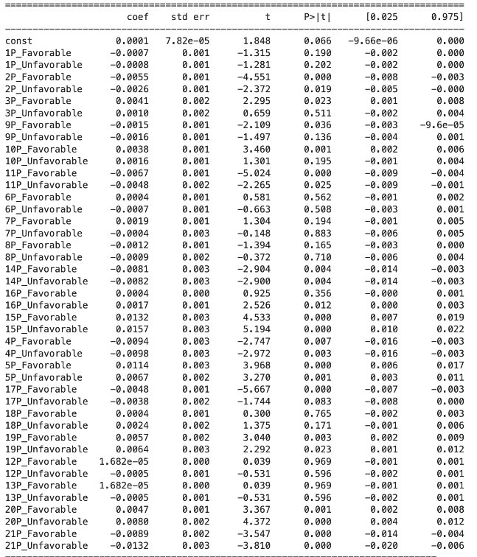
Ball Corporation

Slide 35
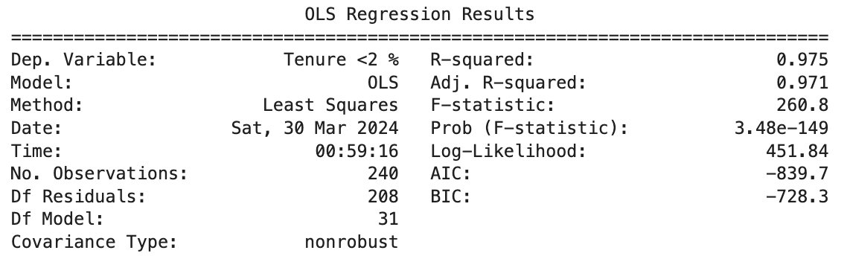
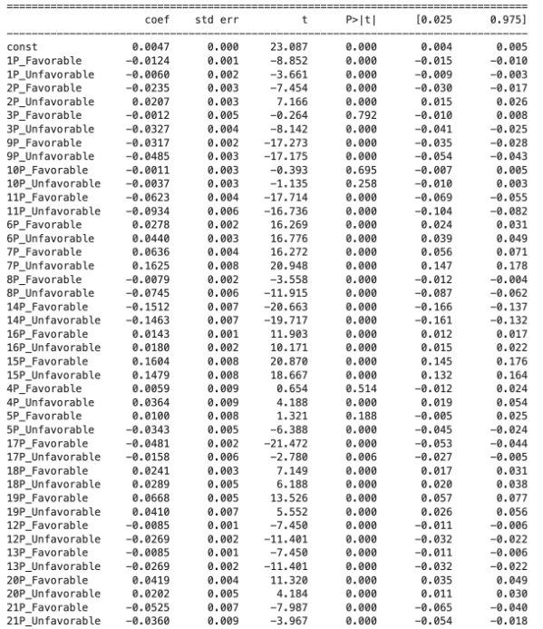
Ball Corporation

Slide 36
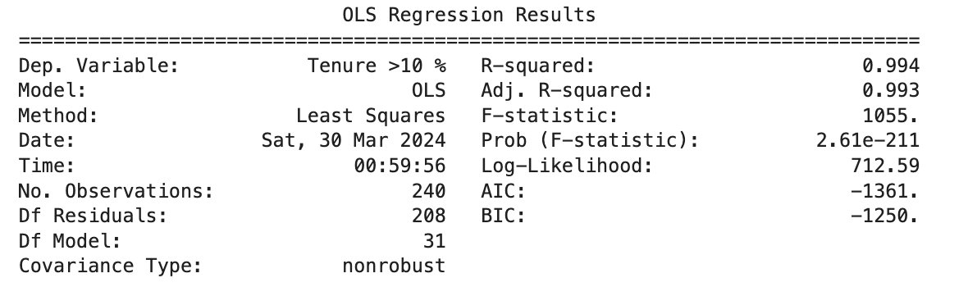
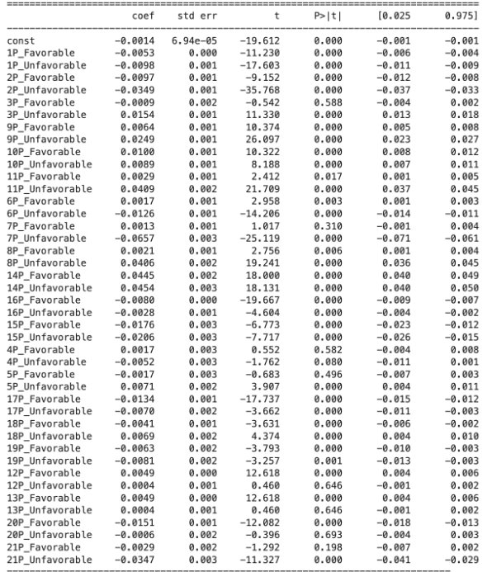
Ball Corporation

Slide 37
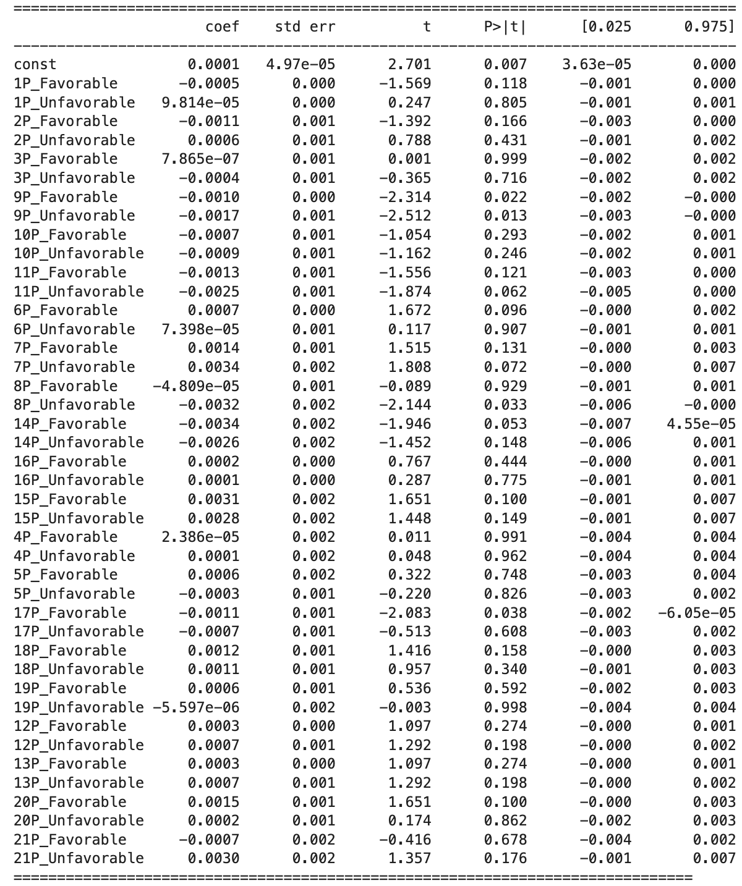
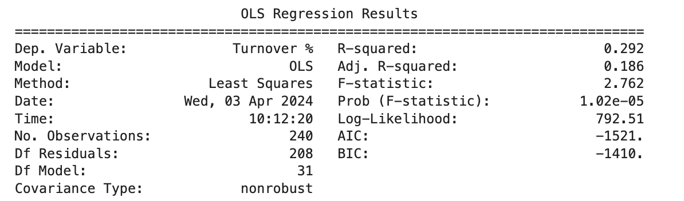
Ball Corporation

Slide 38
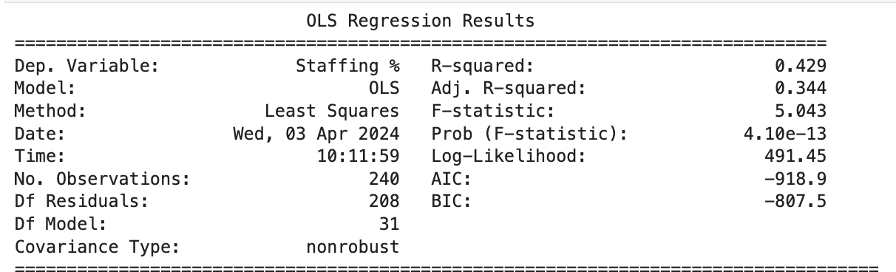
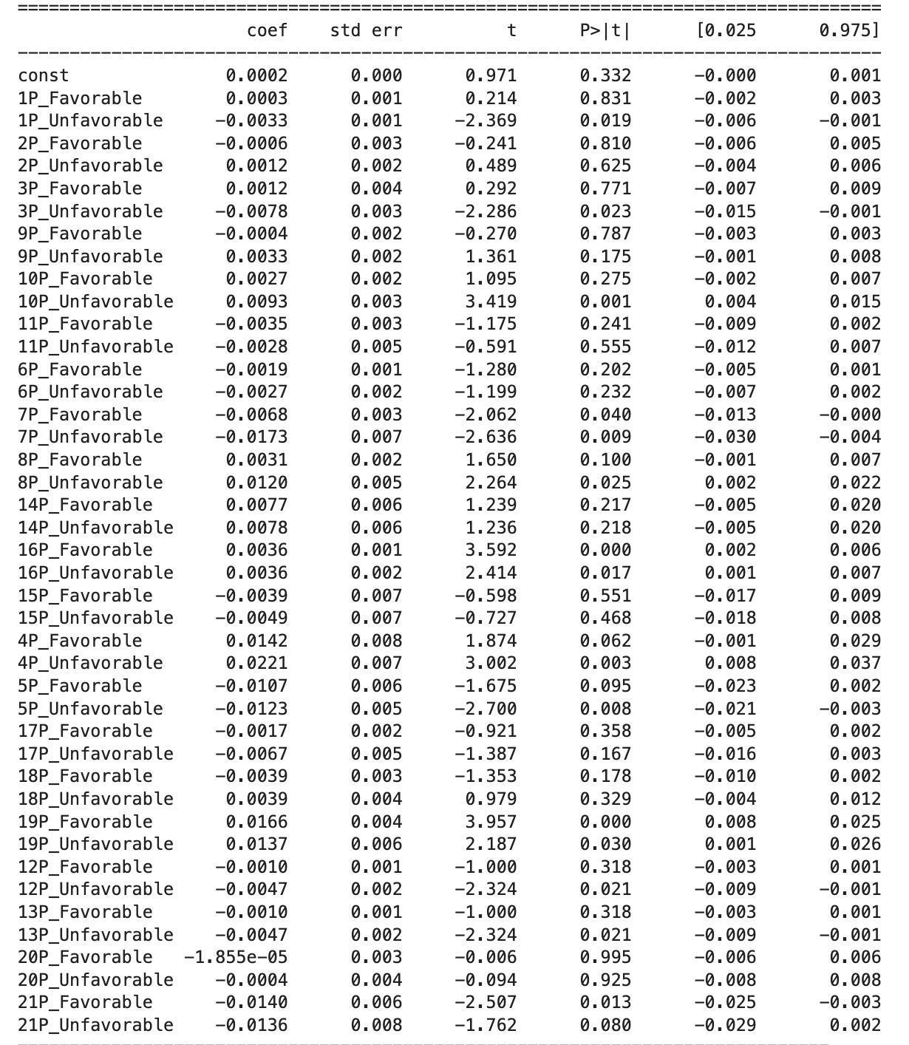
Ball Corporation

Slide 39
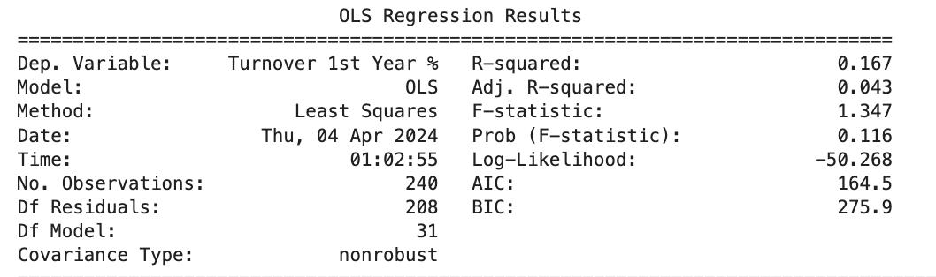
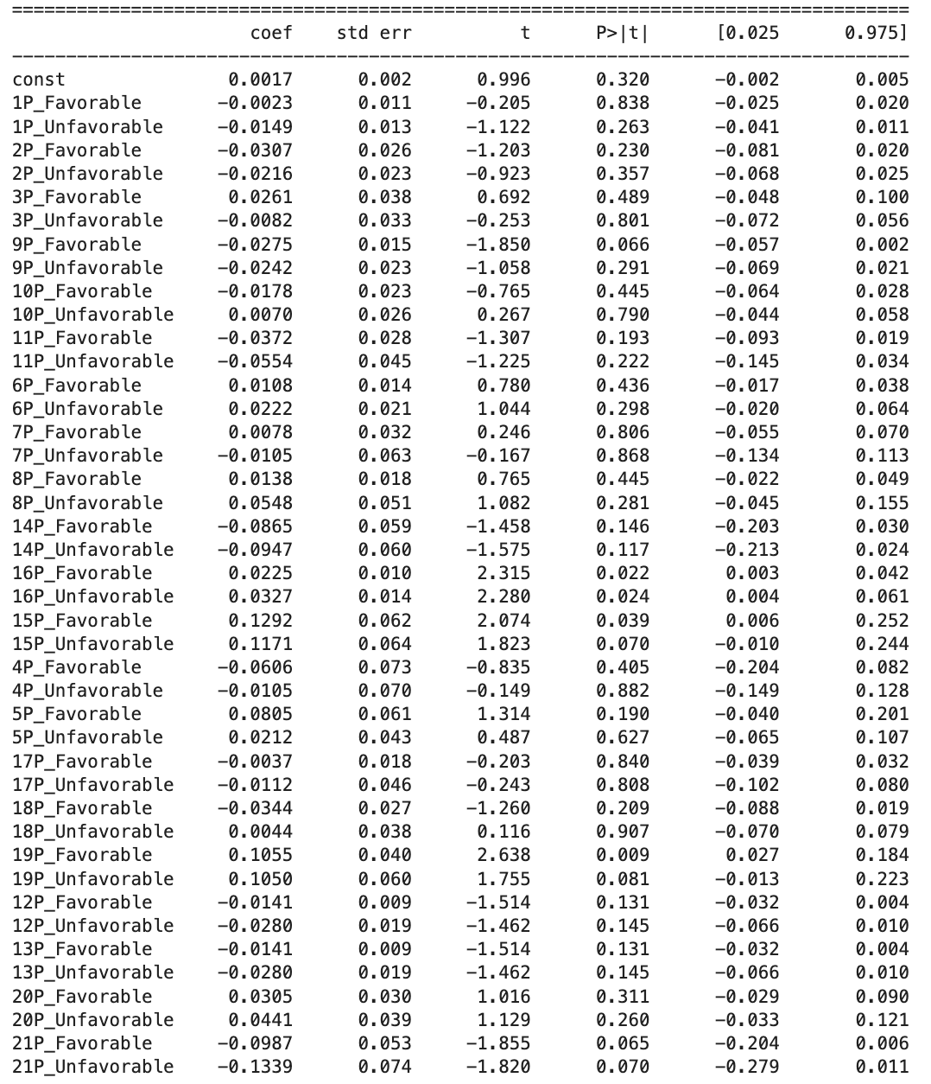
Ball Corporation

Slide 40
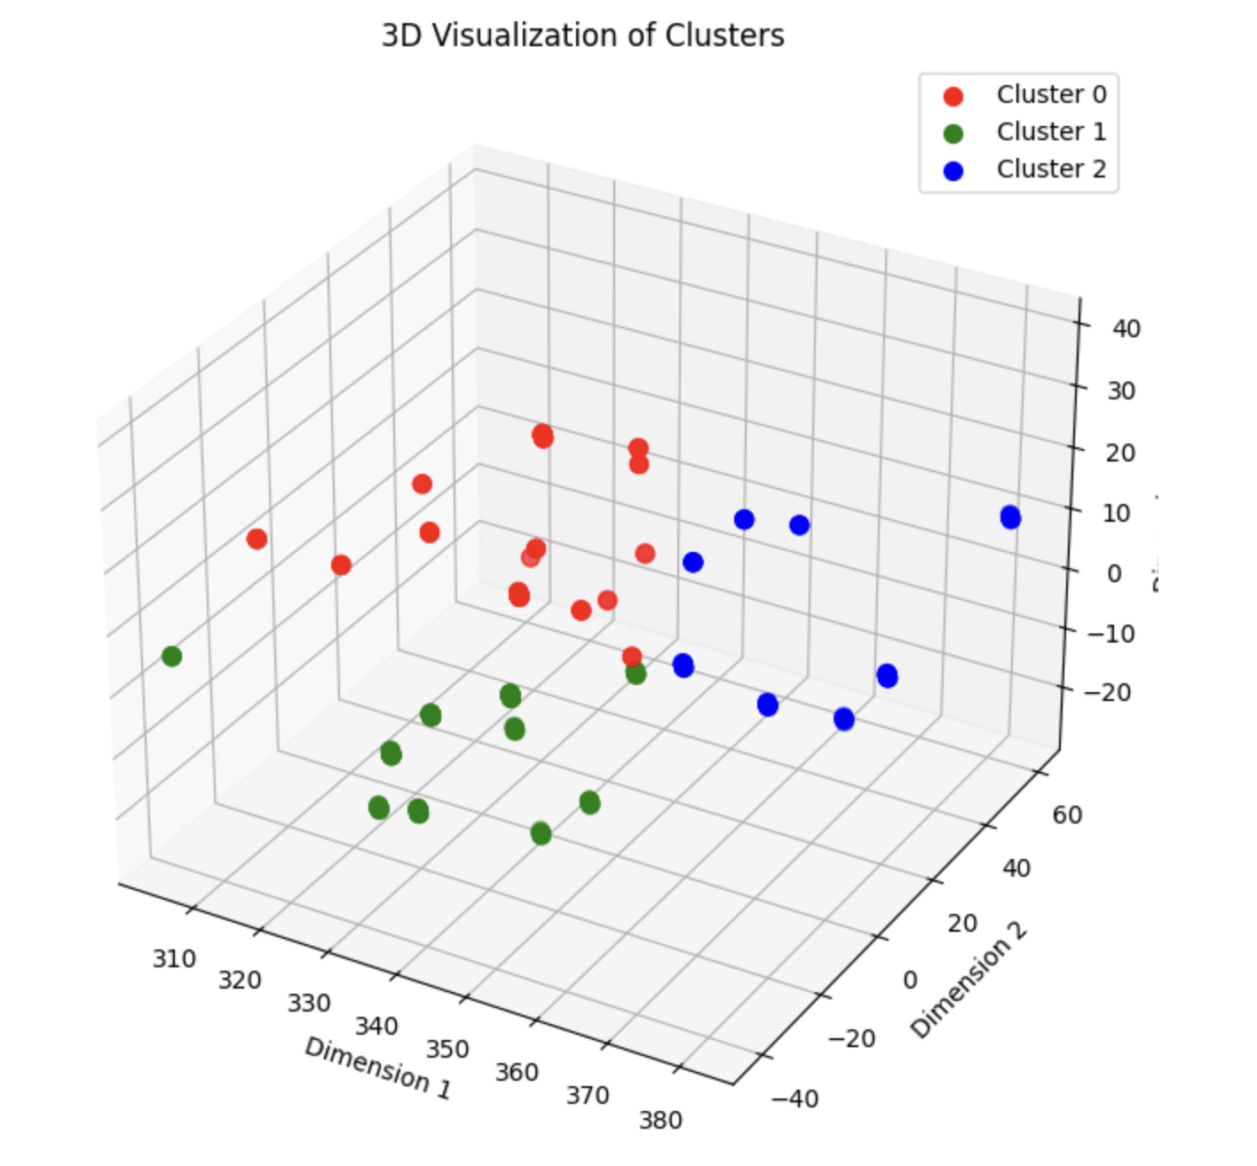
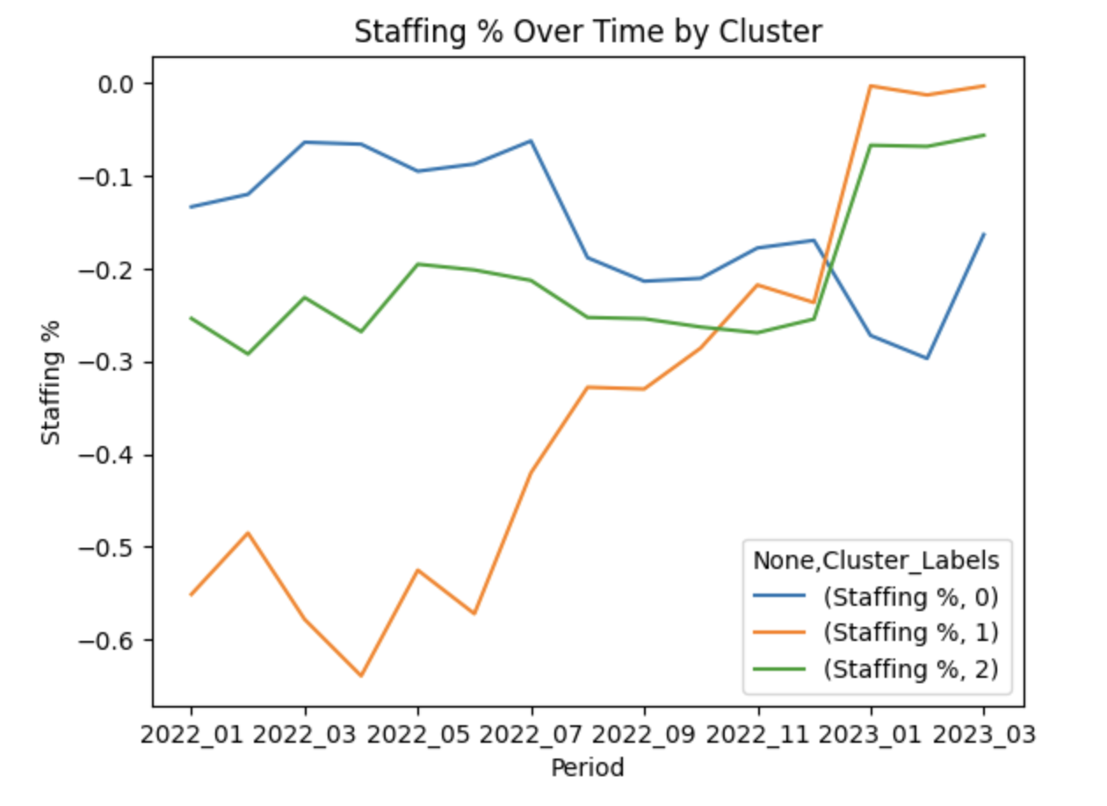
Cluster Analysis

Slide 41
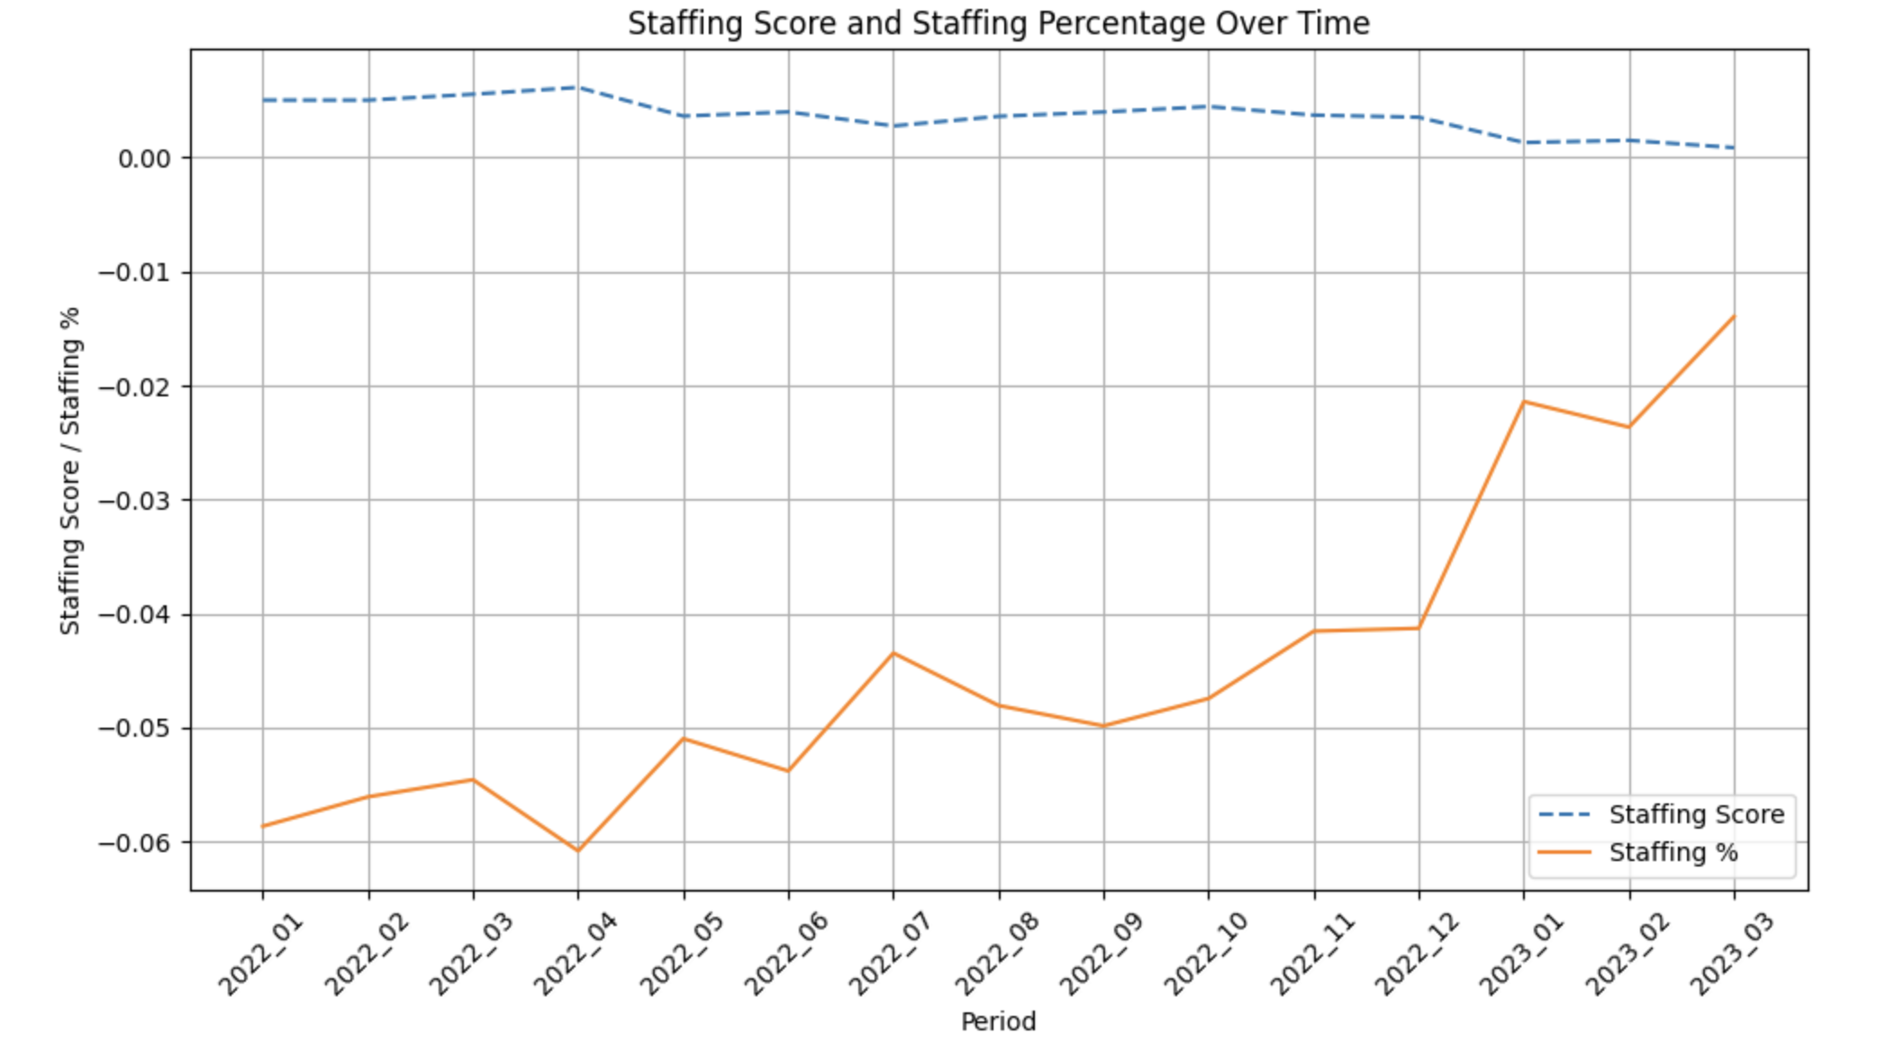
Staffing Analysis

Slide 42
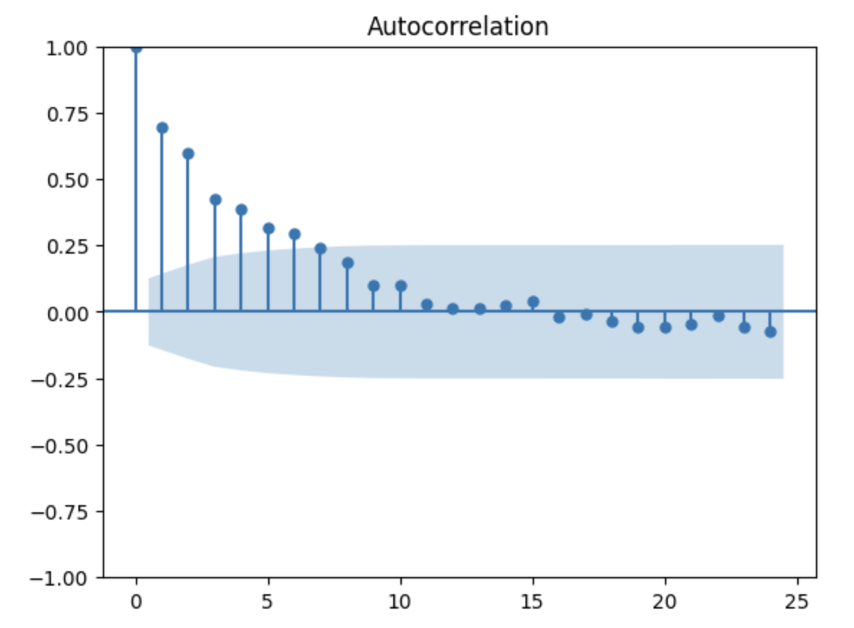
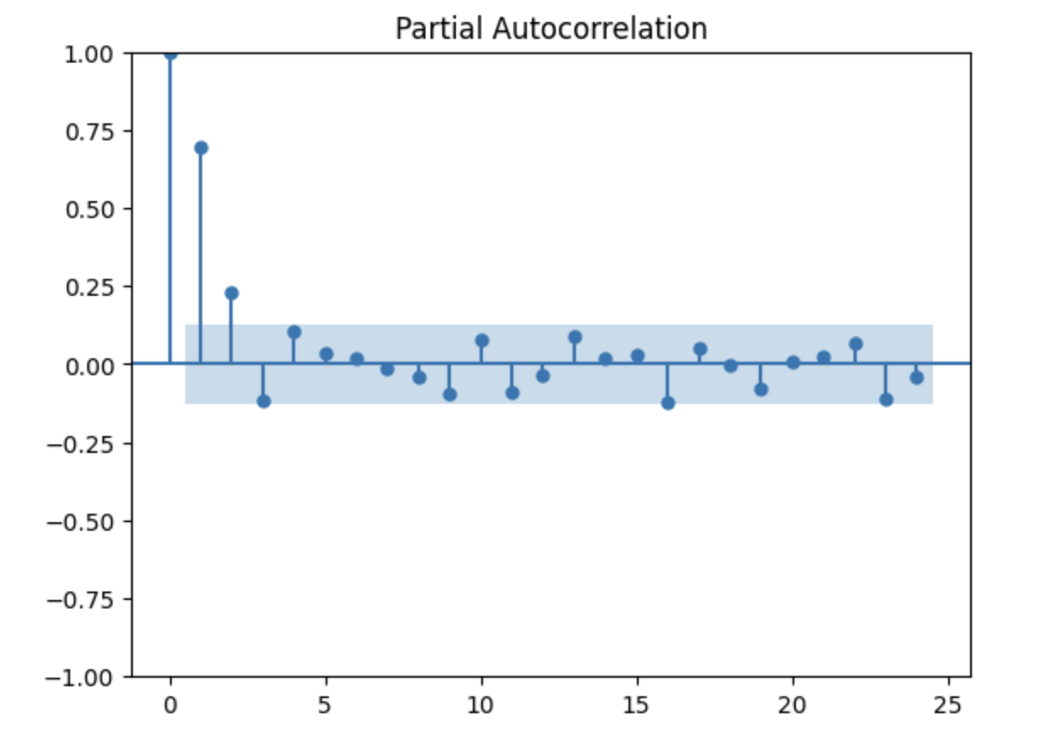
Time Series Analysis

